Slide 1
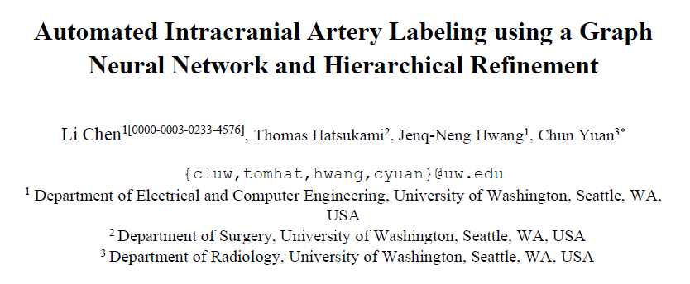
Automated Intracranial Artery Labeling using a Graph Neural Network and Hierarchical Refinement
REVIEW

Slide 2
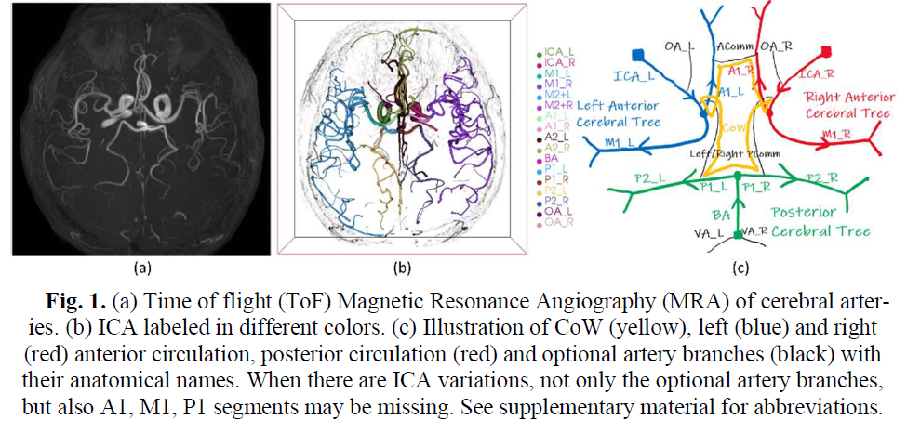
17개?

Slide 3
Graph neural network (GNN) for node and edge probabilities
Automated Intracranial Artery Labeling using a Graph Neural Network and Hierarchical Refinement

Slide 4
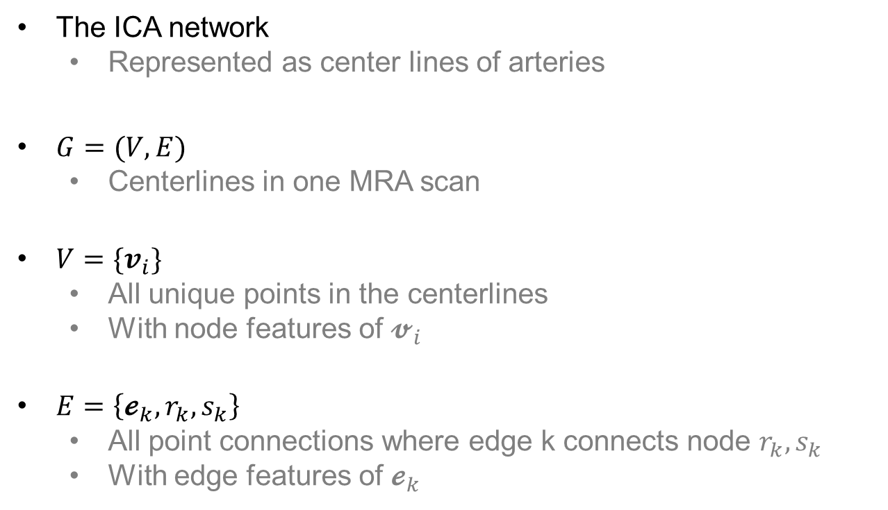
Automated Intracranial Artery Labeling using a Graph Neural Network and Hierarchical Refinement
Graph neural network (GNN) for node and edge probabilities
The ICA network
Represented as center lines of arteries
$G=(V, E)$
Centerlines in one MRA scan
$V=\{v_{i}\}$
All unique points in the centerlines
With node features of $𝓿_{i}$
$E=\left\{𝓮_{k}, r_{k}, s_{k}\right\}$
All point connections where edge k connects node $r_{k}, s_{k}$
With edge features of $𝓮_{k}$

Slide 5
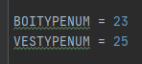
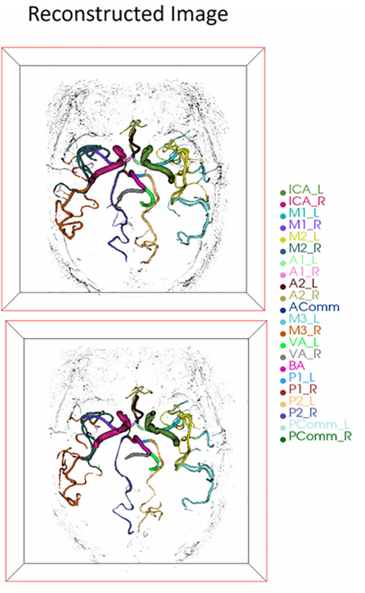
Automated Intracranial Artery Labeling using a Graph Neural Network and Hierarchical Refinement
Graph neural network (GNN) for node and edge probabilities
잘 이해가 가지 않습니다. ni[‘biotype’]이 무슨 뜻일까요?
BOITYPE, VESTYPE?
데이터셋에서 각 노드와 엣지를 분류한 가짓수
BOITYPE (23개)
유의미한 분기점의 가짓수
VESTYPE (25개)
혈관의 가짓수
22개?
Using the UNC dataset, in the serial work from Bogunović et al. [11–13], eight typical ICA graph templates were used to represent ICA with variations, and bifurcations of interest (BoI) were defined and classified so that vessels were labeled indirectly.
https://reader.elsevier.com/reader/sd/pii/S0730725X18305381?token=3C98CFD28C0D0C9469A5337A466B9F1DA0F260E95AC8301CD606D181F4B6B457000AA95A04F87B7A11297DFEF27FCBAE

Slide 6
Automated Intracranial Artery Labeling using a Graph Neural Network and Hierarchical Refinement
Graph neural network (GNN) for node and edge probabilities
잘 이해가 가지 않습니다. ni[‘biotype’]이 무슨 뜻일까요?
BOITYPE, VESTYPE?
그러나 논문에서는 모든 엣지, 노트를 라벨하려고 하지 않음
중요한 일부만 추정
22개?
Using the UNC dataset, in the serial work from Bogunović et al. [11–13], eight typical ICA graph templates were used to represent ICA with variations, and bifurcations of interest (BoI) were defined and classified so that vessels were labeled indirectly.
https://reader.elsevier.com/reader/sd/pii/S0730725X18305381?token=3C98CFD28C0D0C9469A5337A466B9F1DA0F260E95AC8301CD606D181F4B6B457000AA95A04F87B7A11297DFEF27FCBAE

Slide 7
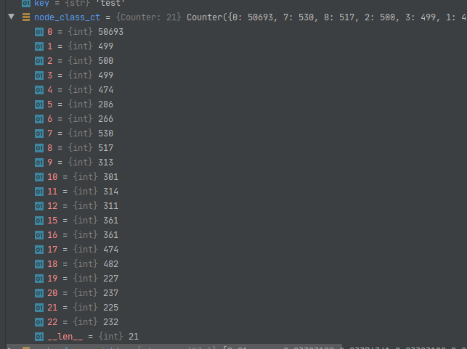
Automated Intracranial Artery Labeling using a Graph Neural Network and Hierarchical Refinement
Graph neural network (GNN) for node and edge probabilities
잘 이해가 가지 않습니다. ni[‘biotype’]이 무슨 뜻일까요?
BOITYPE
데이터셋의 노드 클래스 카운트시
0부터 22까지 중 개수를 셈 (총 23개)
논문에서는 21가지 중 하나로 라벨
With similar purpose of BoI [11–13], we remove all nodes with a degree of 2 to reduce the graph size, as nodes requiring labeling are usually at bifurcations or ending points. If the remaining nodes are correctly predicted as one of the 21 possible bifurcation/ending types, then the ICA (edges) can be labeled based on their connections.
Probability 𝑃_nt(𝑖) for node 𝑖 being bifurcation/ending type 𝑛𝑡 ∈{0: 𝑁𝑜𝑛_𝑇𝑦𝑝𝑒, 1: 𝐼𝐶𝐴_𝑅𝑜𝑜𝑡_𝐿, … ,20: 𝐼𝐶𝐴_𝑃𝐶𝑜𝑚𝑚} is calculated using a softmax function of GNN output 𝑂 _nt(𝑖).
The predicted node type 𝑇_n(𝑖) is then identified by selecting the node type with the maximum probability.

Slide 8
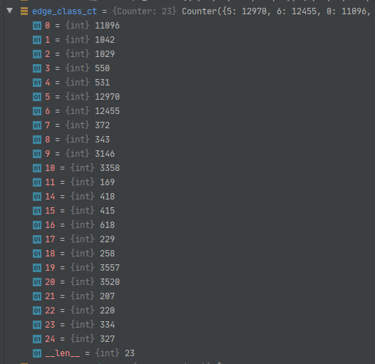
Automated Intracranial Artery Labeling using a Graph Neural Network and Hierarchical Refinement
Graph neural network (GNN) for node and edge probabilities
잘 이해가 가지 않습니다. ni[‘biotype’]이 무슨 뜻일까요?
VESTYPE
데이터셋의 엣지 클래스 카운트시
0부터 24까지 중 개수를 셈 (총 25개)
논문에서는 23가지 중 하나로 라벨
Similar for edges, 𝑒𝑡 ∈ {0: 𝑁𝑜𝑛_𝑇𝑦𝑝𝑒, 1: 𝐼𝐶𝐴_𝐿, … ,22: 𝑂𝐴_𝑅}, the edge probability and predicted edge type are

Slide 9
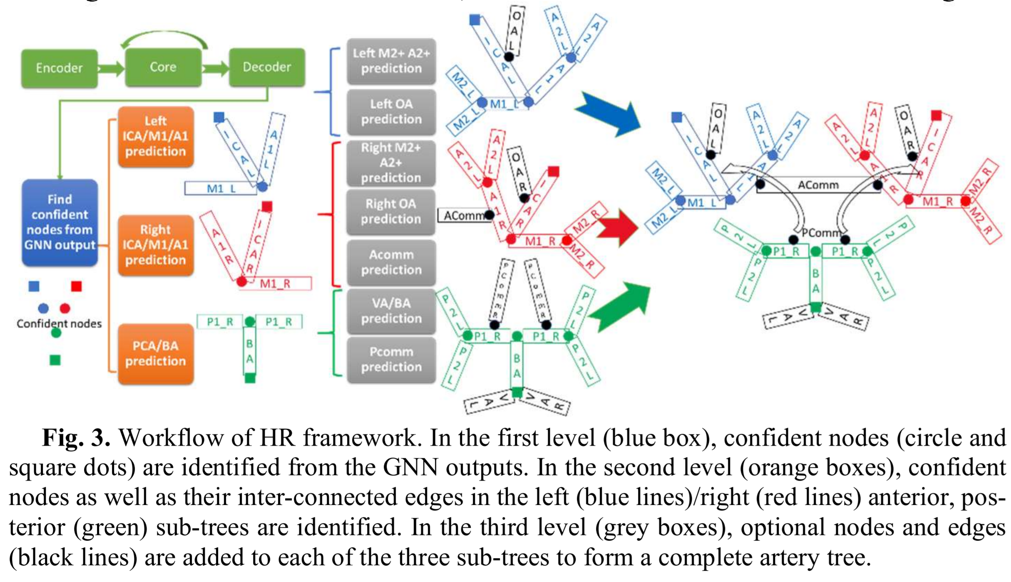
Automated Intracranial Artery Labeling using a Graph Neural Network and Hierarchical Refinement
Graph neural network (GNN) for node and edge probabilities
잘 이해가 가지 않습니다. ni[‘biotype’]이 무슨 뜻일까요?
VESTYPE
네모 칸만 세면 23개

Slide 10
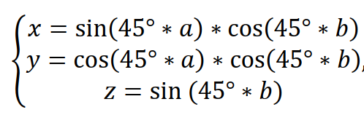
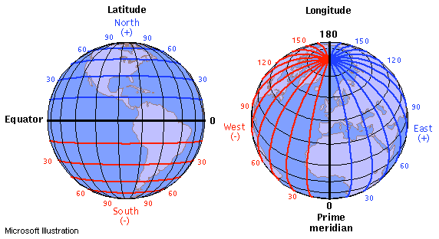
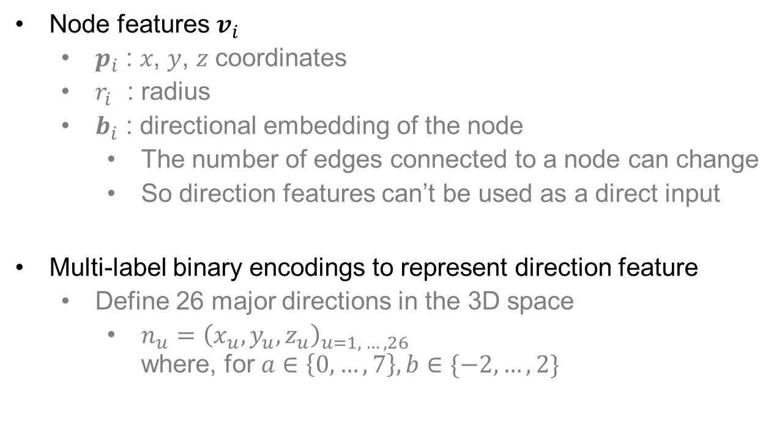
Automated Intracranial Artery Labeling using a Graph Neural Network and Hierarchical Refinement
Graph neural network (GNN) for node and edge probabilities
Node features $v_{i}$
$p_{i}$ : 𝑥, 𝑦, 𝑧 coordinates
$r_{i}$ : radius
$b_{i}$ : directional embedding of the node
The number of edges connected to a node can change
So direction features can’t be used as a direct input
Multi-label binary encodings to represent direction feature
Define 26 major directions in the 3D space
$n_{u}={\left(x_{u}, y_{u}, z_{u}\right)}_{u=1, …, 26}$ where, for $a∈\left\{0, …,7\right\},b∈\{−2, …,2\}$

Slide 11
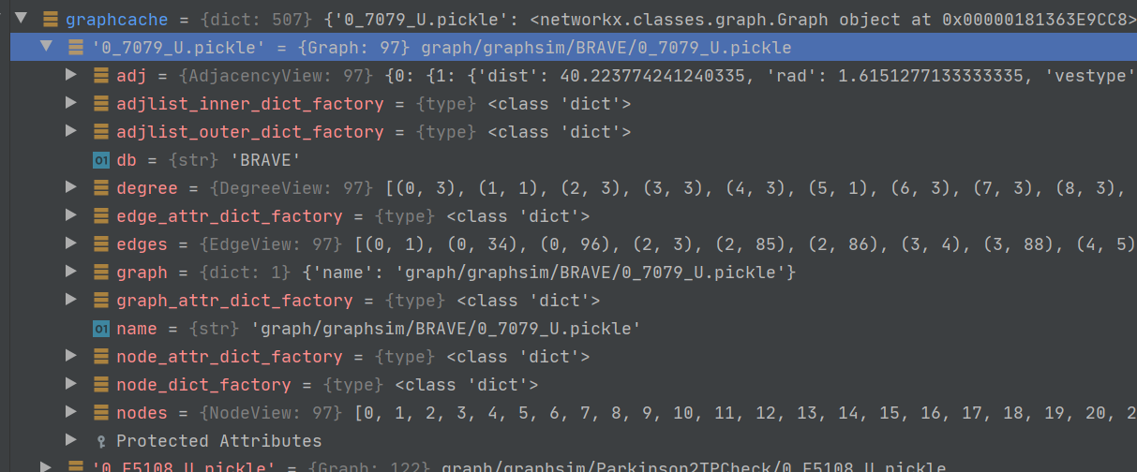
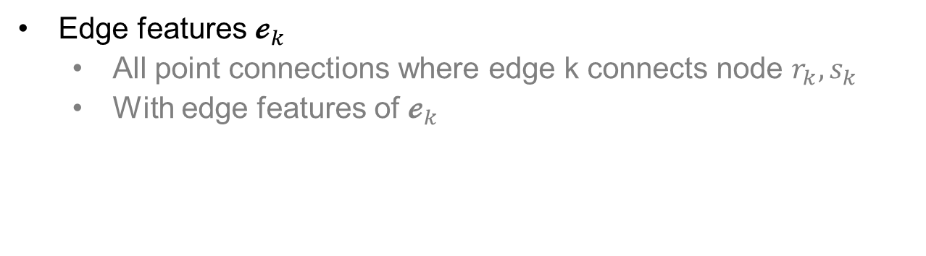
Automated Intracranial Artery Labeling using a Graph Neural Network and Hierarchical Refinement
Graph neural network (GNN) for node and edge probabilities
이러한 node, edge feature들을 ipynb 코드 어느 부분에서 볼 수 있을까요?
Edge features $𝓮_{k}$
All point connections where edge k connects node $r_{k}, s_{k}$
With edge features of $𝓮_{k}$

Slide 12
Automated Intracranial Artery Labeling using a Graph Neural Network and Hierarchical Refinement
Graph neural network (GNN) for node and edge probabilities
이러한 node, edge feature들을 ipynb 코드 어느 부분에서 볼 수 있을까요?
graph
해당 그래프의 경로
=> 지금 살펴볼 그래프는 해당 경로에서 불러온 0_7079 그래프

Slide 13
Automated Intracranial Artery Labeling using a Graph Neural Network and Hierarchical Refinement
Graph neural network (GNN) for node and edge probabilities
이러한 node, edge feature들을 ipynb 코드 어느 부분에서 볼 수 있을까요?
nodes
각각의 노드에 할당된 번호
=> 0_7079는 총 97개의 노드 존재

Slide 14
Automated Intracranial Artery Labeling using a Graph Neural Network and Hierarchical Refinement
Graph neural network (GNN) for node and edge probabilities
이러한 node, edge feature들을 ipynb 코드 어느 부분에서 볼 수 있을까요?
degree
각각의 노드에 달린 엣지의 개수 (=다른 노드와 연결)
모든 노드 최소 1 이상 (1이면 다른 노드와 연결 X)
=> 0번 노드는 3개의 노드와 연결, 1번 노드는 1개의 노드와 연결, …

Slide 15
Automated Intracranial Artery Labeling using a Graph Neural Network and Hierarchical Refinement
Graph neural network (GNN) for node and edge probabilities
이러한 node, edge feature들을 ipynb 코드 어느 부분에서 볼 수 있을까요?
degree
각각의 노드에 달린 엣지의 개수 (=다른 노드와 연결)
모든 노드 최소 1 이상
=> 0번 노드는 3개의 노드와 연결, 1번 노드는 1개의 노드와 연결, …
[(0, 3), (1, 1), (2, 3), (3, 3), (4, 3), (5, 1), (6, 3), (7, 3), (8, 3), (9, 3), (10, 1), (11, 3), (12, 3), (13, 1), (14, 3), (15, 1), (16, 1), (17, 3), (18, 3), (19, 3), (20, 3), (21, 3), (22, 3), (23, 3), (24, 1), (25, 1), (26, 3), (27, 1), (28, 3), (29, 1), (30, 3), (31, 1), (32, 3), (33, 1), (34, 3), (35, 3), (36, 1), (37, 3), (38, 1), (39, 1), (40, 1), (41, 3), (42, 1), (43, 1), (44, 1), (45, 3), (46, 3), (47, 3), (48, 3), (49, 3), (50, 1), (51, 3), (52, 1), (53, 1), (54, 1), (55, 3), (56, 1), (57, 3), (58, 1), (59, 3), (60, 3), (61, 3), (62, 3), (63, 1), (64, 1), (65, 3), (66, 1), (67, 3), (68, 1), (69, 1), (70, 1), (71, 1), (72, 3), (73, 3), (74, 1), (75, 1), (76, 1), (77, 1), (78, 3), (79, 1), (80, 1), (81, 1), (82, 1), (83, 4), (84, 3), (85, 3), (86, 3), (87, 1), (88, 1), (89, 1), (90, 1), (91, 1), (92, 1), (93, 1), (94, 3), (95, 1), (96, 1)]

Slide 16
Automated Intracranial Artery Labeling using a Graph Neural Network and Hierarchical Refinement
Graph neural network (GNN) for node and edge probabilities
이러한 node, edge feature들을 ipynb 코드 어느 부분에서 볼 수 있을까요?
edges
서로 연결된 노드와 노드의 번호
=> 0번 노드는 3개의 노드와 연결 (0과 1, 0과 34, 0과 96)
=> 1번 노드는 다른 노드와 연결 X (그래서 edges에 없음)

Slide 17
Automated Intracranial Artery Labeling using a Graph Neural Network and Hierarchical Refinement
Graph neural network (GNN) for node and edge probabilities
이러한 node, edge feature들을 ipynb 코드 어느 부분에서 볼 수 있을까요?
[(0, 1), (0, 34), (0, 96), (2, 3), (2, 85), (2, 86), (3, 4), (3, 88), (4, 5), (4, 53), (6, 7), (6, 62), (6, 22), (7, 8), (7, 78), (8, 9), (8, 41), (9, 10), (9, 25), (11, 12), (11, 59), (11, 60), (12, 13), (12, 70), (14, 15), (14, 26), (14, 27), (16, 17), (17, 18), (17, 81), (18, 19), (18, 40), (19, 20), (19, 26), (20, 47), (20, 84), (21, 22), (21, 34), (21, 35), (22, 55), (23, 24), (23, 95), (23, 94), (26, 43), (28, 29), (28, 35), (28, 36), (30, 31), (30, 61), (30, 57), (32, 33), (32, 41), (32, 77), (34, 46), (35, 39), (37, 38), (37, 48), (37, 51), (41, 42), (44, 45), (45, 83), (45, 47), (46, 47), (46, 94), (48, 49), (48, 90), (49, 50), (49, 91), (51, 52), (51, 84), (54, 55), (55, 63), (56, 57), (57, 65), (58, 59), (59, 75), (60, 61), (60, 73), (61, 62), (62, 64), (65, 66), (65, 67), (67, 68), (67, 69), (71, 72), (72, 73), (72, 76), (73, 74), (78, 79), (78, 80), (82, 83), (83, 83), (84, 85), (85, 89), (86, 87), (86, 92), (93, 94)]
edges
서로 연결된 노드와 노드의 번호
=> 0번 노드는 3개의 노드와 연결 (0과 1, 0과 34, 0과 96)
=> 1번 노드는 다른 노드와 연결 X (그래서 edges에 없음)

Slide 18
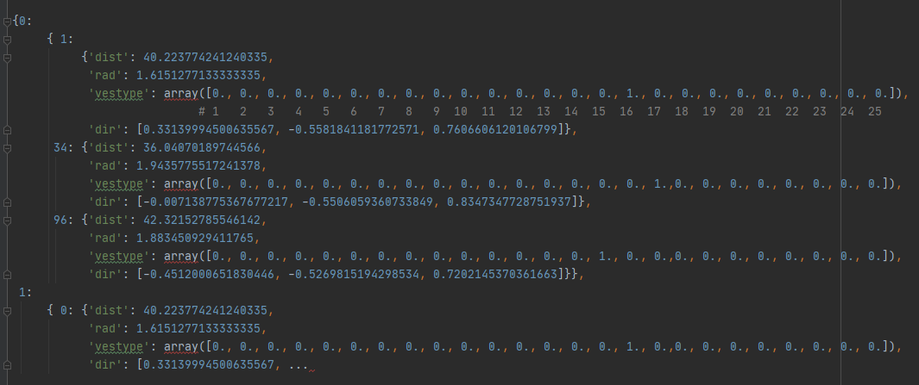
Automated Intracranial Artery Labeling using a Graph Neural Network and Hierarchical Refinement
Graph neural network (GNN) for node and edge probabilities
이러한 node, edge feature들을 ipynb 코드 어느 부분에서 볼 수 있을까요?
adj
dist, rad, vestype, dir
5개 데이터셋이 모두 동일한 방식으로 저장되어 있음
=> 0번 노드에서 1번 노드에 대해 적힌 정보와, 거꾸로 1번 노드에서 0번 노드에 대해 적힌 정보가 동일

Slide 19
Automated Intracranial Artery Labeling using a Graph Neural Network and Hierarchical Refinement
Graph neural network (GNN) for node and edge probabilities
이러한 node, edge feature들을 ipynb 코드 어느 부분에서 볼 수 있을까요?
adj
dist
각 노드끼리 거리 = 해당 엣지 혈관의 길이
rad
해당 엣지 혈관의 두께 radius

Slide 20
Automated Intracranial Artery Labeling using a Graph Neural Network and Hierarchical Refinement
Graph neural network (GNN) for node and edge probabilities
이러한 node, edge feature들을 ipynb 코드 어느 부분에서 볼 수 있을까요?
adj
vestype
25개의 vestype 중 어느 것에 속하는지 onehot encoding으로 표현
dir
(x,y,z) 3개의 변수로 표현한 directional embedding of the node

Slide 21
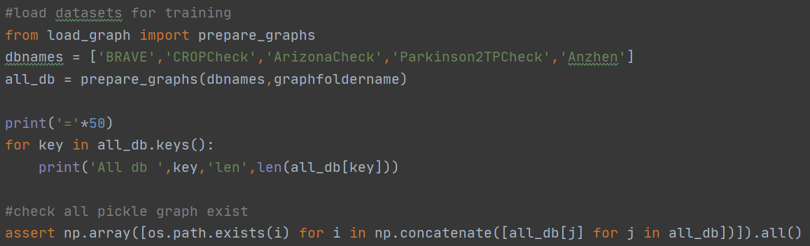
Automated Intracranial Artery Labeling using a Graph Neural Network and Hierarchical Refinement
Graph neural network (GNN) for node and edge probabilities
Load dataset

Slide 22
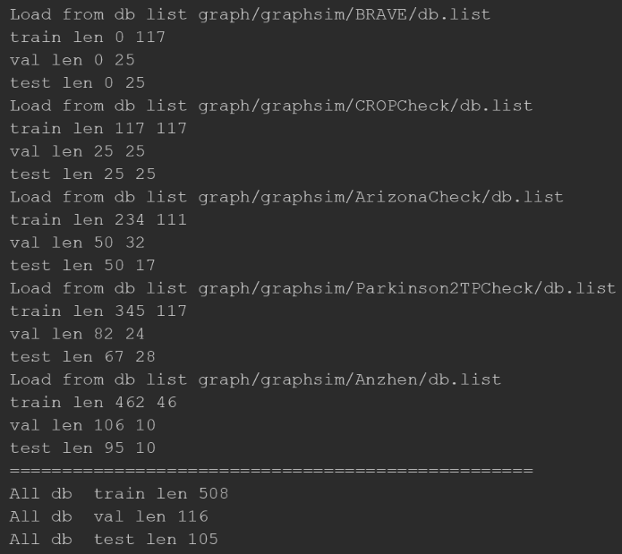
Automated Intracranial Artery Labeling using a Graph Neural Network and Hierarchical Refinement
Graph neural network (GNN) for node and edge probabilities
Load dataset
네. Db별로 train/val/test를 분리한 것 같습니다.

Slide 23
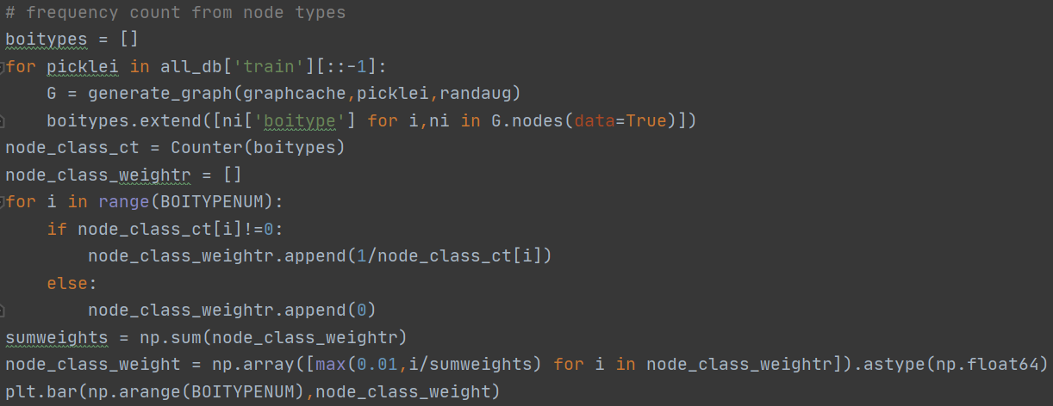
Automated Intracranial Artery Labeling using a Graph Neural Network and Hierarchical Refinement
Graph neural network (GNN) for node and edge probabilities
Frequency count : node
잘 이해가 가지 않습니다.
ni[‘biotype’]이 무슨 뜻일까요?
https://reader.elsevier.com/reader/sd/pii/S0730725X18305381?token=3C98CFD28C0D0C9469A5337A466B9F1DA0F260E95AC8301CD606D181F4B6B457000AA95A04F87B7A11297DFEF27FCBAE

Slide 24
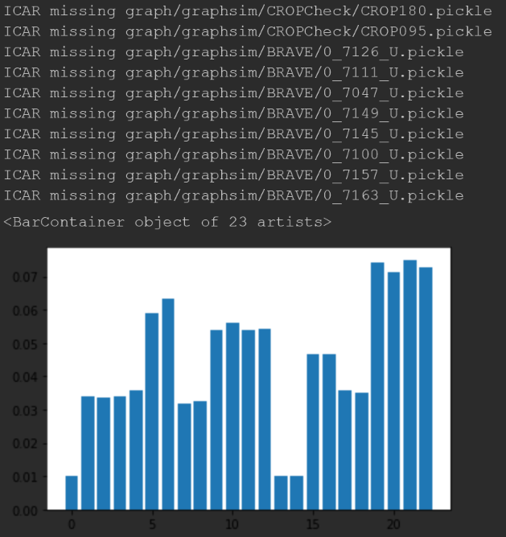
Automated Intracranial Artery Labeling using a Graph Neural Network and Hierarchical Refinement
Graph neural network (GNN) for node and edge probabilities
Frequency count : node
Bar그래프의 x축과 y축이 안 나와있네요.

Slide 25
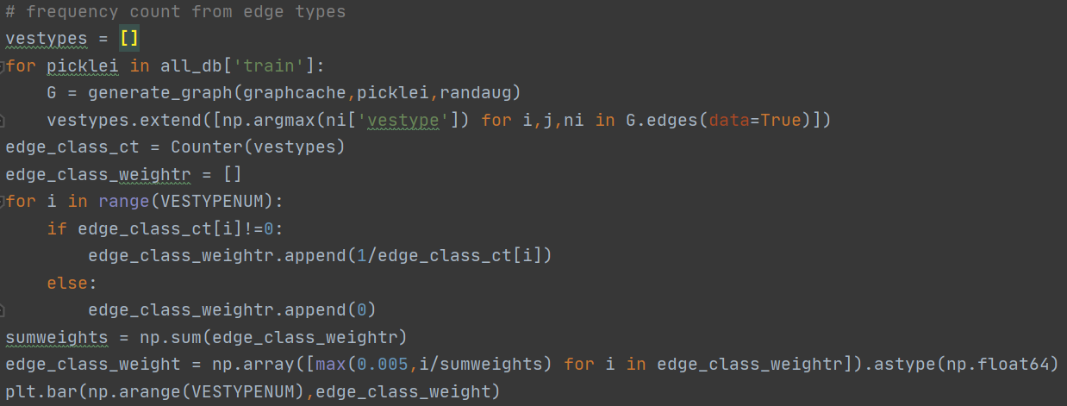
Automated Intracranial Artery Labeling using a Graph Neural Network and Hierarchical Refinement
Graph neural network (GNN) for node and edge probabilities
Frequency count : edge
Generate_graph라는 함수는 어디에서 나온 함수인가요?

Slide 26
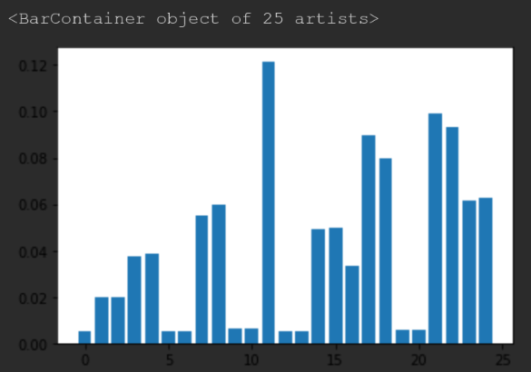
Automated Intracranial Artery Labeling using a Graph Neural Network and Hierarchical Refinement
Graph neural network (GNN) for node and edge probabilities
Frequency count : edge
Bar그래프의 x축과 y축이 안 나와있네요.

Slide 27
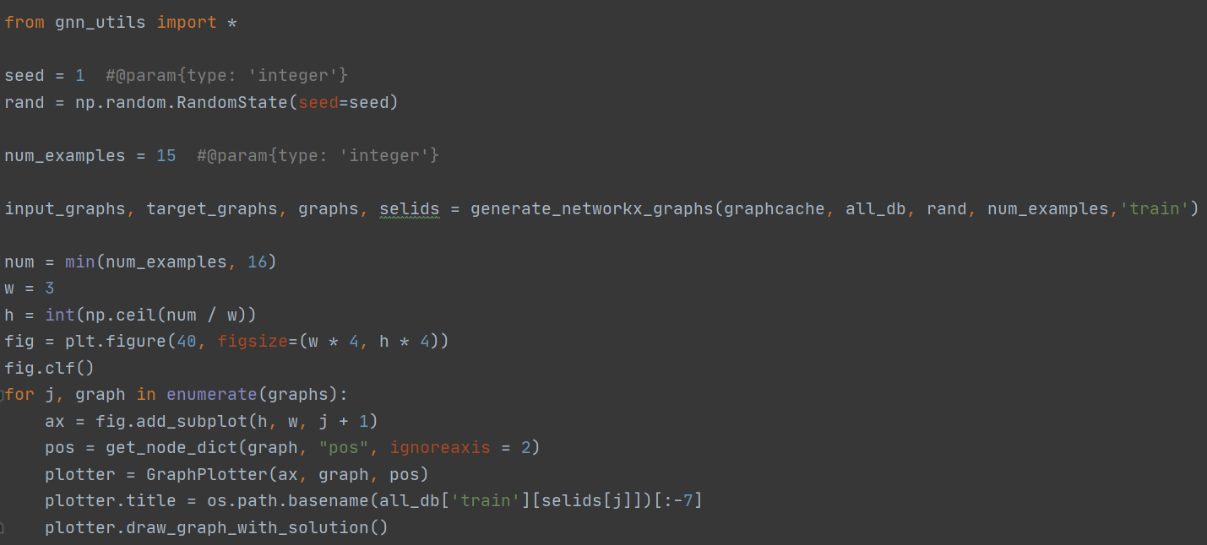
Automated Intracranial Artery Labeling using a Graph Neural Network and Hierarchical Refinement
Graph neural network (GNN) for node and edge probabilities
Visualize example graphs
gnn_utils는 어디에서 왔는지요?

Slide 28
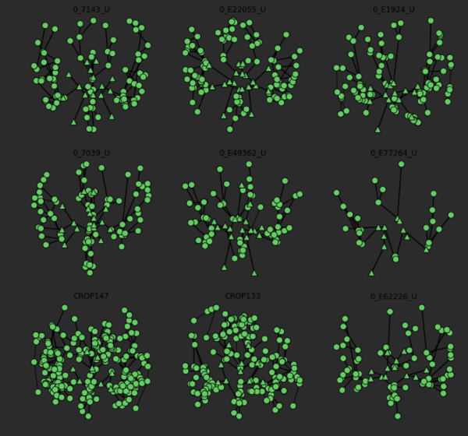
Automated Intracranial Artery Labeling using a Graph Neural Network and Hierarchical Refinement
Graph neural network (GNN) for node and edge probabilities
Visualize example graphs

Slide 30
Automated Intracranial Artery Labeling using a Graph Neural Network and Hierarchical Refinement
Graph neural network (GNN) for node and edge probabilities
Message passing GNN framework
proposed in [16, 21]
21. Gilmer, J., Schoenholz, S.S., Riley, P.F., Vinyals, O., Dahl, G.E.: Neural Message Passing for Quantum Chemistry. arXiv:1704.01212v2
Predict the types for each node and edge

Slide 31
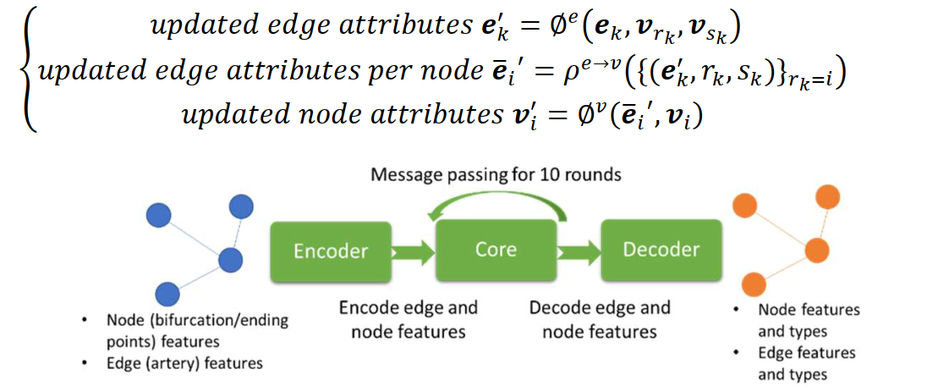
Automated Intracranial Artery Labeling using a Graph Neural Network and Hierarchical Refinement
Graph neural network (GNN) for node and edge probabilities
Message passing GNN framework
Input
a graph with node and edge features
Encoder
input features of edges and nodes in the graph are encoded to an embedding
Output
a graph with additional features for node and edge types

Slide 32
Automated Intracranial Artery Labeling using a Graph Neural Network and Hierarchical Refinement
Graph neural network (GNN) for node and edge probabilities
Training loss
combined weighted cross entropy losses
in both nodes and edges
Weighted loss
Inverse proportional to frequencies of the node and edge types
i.e. Frequent node/edge type → smaller weight on loss

Slide 33
Automated Intracranial Artery Labeling using a Graph Neural Network and Hierarchical Refinement
Graph neural network (GNN) for node and edge probabilities
Miscellaneous training setups
Batch size
32 graphs
Optimizer
Adam
Normalization
Positions of nodes from different datasets normalized based on the imaging resolution
Data augmentation
Random translation of positions (within 10%)

Slide 34
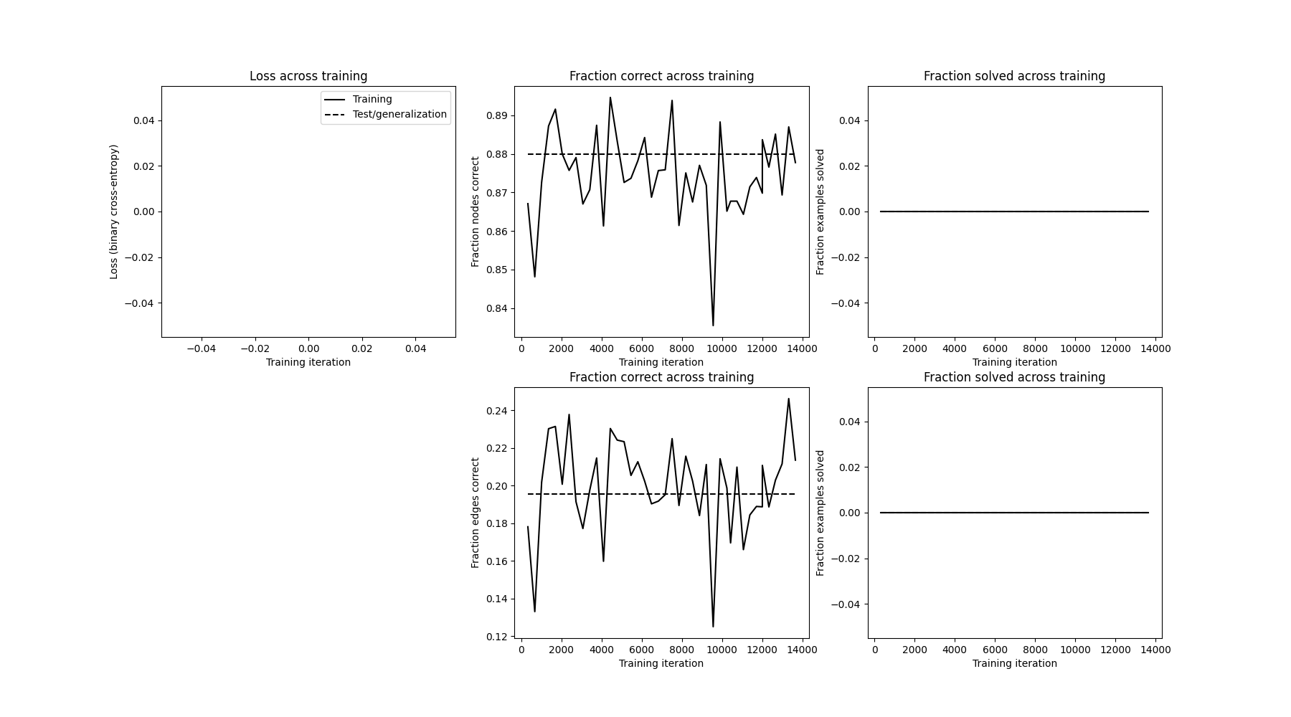
Automated Intracranial Artery Labeling using a Graph Neural Network and Hierarchical Refinement
Graph neural network (GNN) for node and edge probabilities
Loss

